Slide 1
Territory and Quota Planning Configurator Exercise
Updated March 2026

Slide 2
8 Item Agenda
Data Hub Setup
Historical/Account Value KPI
Hierarchies
Target Allocation
Scenario Planning
Territory & Resource Assignment
Optimizer
Rule-based Automated Assignment

Slide 3
Data Hub Setup

Slide 4

Datahub Setup – Define the data landscape for the application
Capture all relevant data objects that will be referenced in planning
Rename and capture additional attributes per data object
Hint: Leverage “Enable for Calculation” to capture additional attributes that will need to be in a list

Slide 5
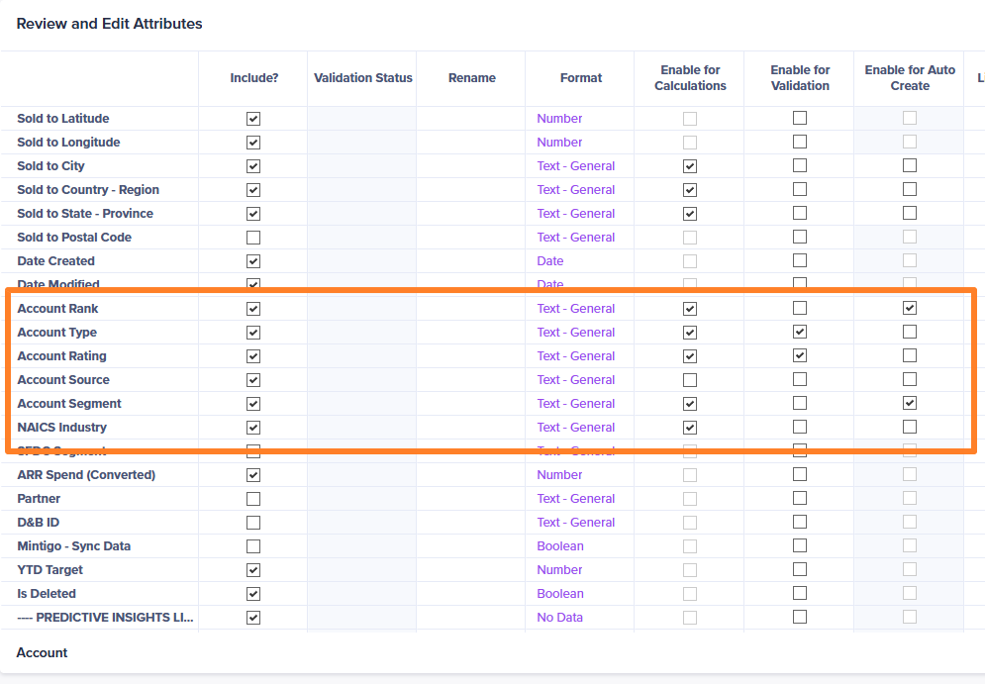
Account – Enable for Calculation / Auto Creation
Ensure key attributes that will be use for reporting or calculation is checked for “Enable for Calculation” and “Enable for Auto-Create”
Example attributes:
Account Rank
Account Type
Account Segment
Industry
Business Type

Slide 6
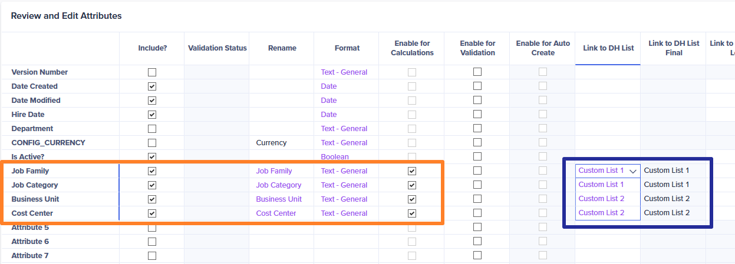
Employee – Enable for Calculation/ Custom List
New Attributes added:
  Job Family
  Job Category
  Business Unit
  Cost Center

Slide 7
Hierarchies

Slide 8

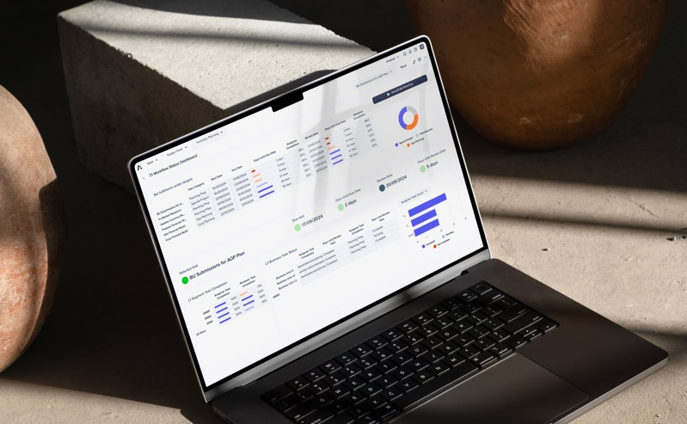
Hierarchies
Define the levels and names of your hierarchies (For any hierarchy lists defined in Datahub setup)
After the update, hit apply and map attributes that was “enable for calculate” for applicable hierarchies
Hint: It is recommended to add a suffix to the name to represent the level ie. L1, L2, L3 etc.

Slide 9
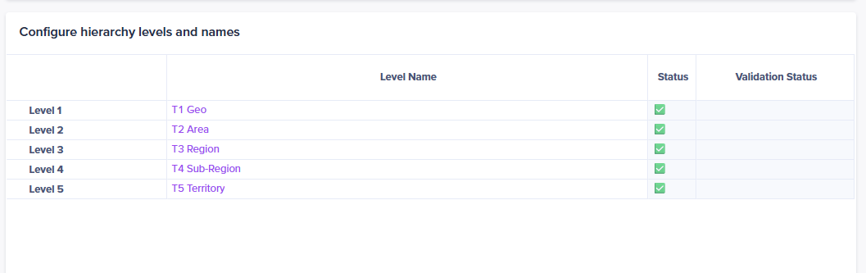
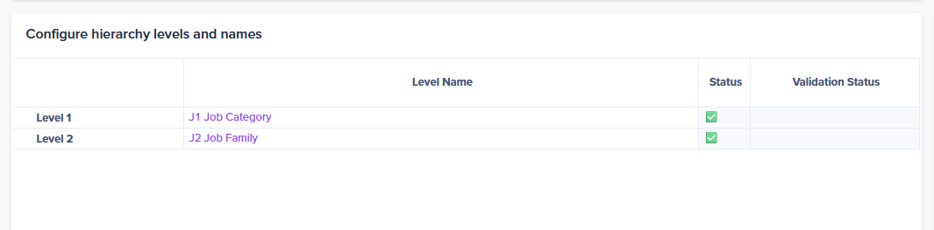
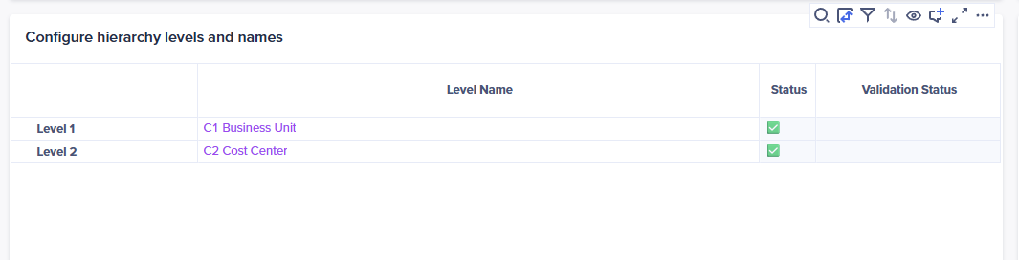
Hierarchies - Examples

Slide 10
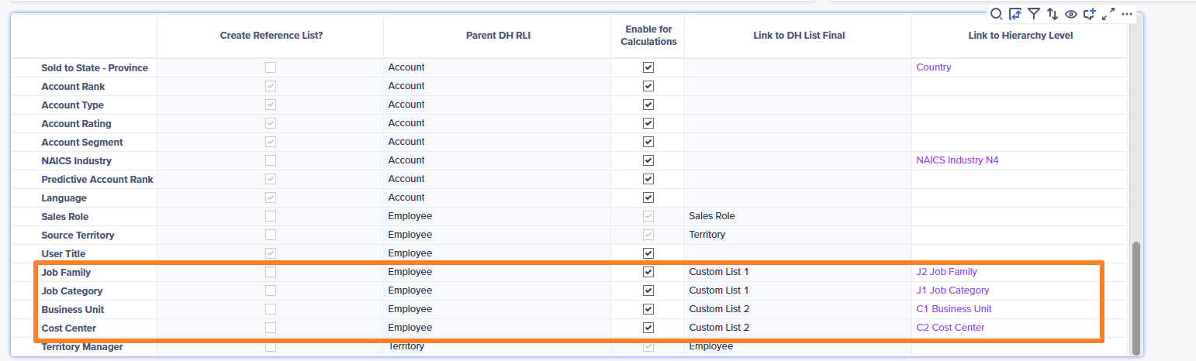
Hierarchies Mapping - Example

Slide 11
Scenario Planning

Slide 12
Define transaction data sources / Set planning measures
Select the source data table, attribute, time scale, and time offset for calculating actuals and forecasts, and select the source data table and attribute for the field to identify the date.
Add or remove planning measures to be used across the model. These metrics are used for scenario planning, target setting, and quota allocation. For each planning measure, choose the attribute that is used to calculate it for both forecast and actual values.

Slide 13
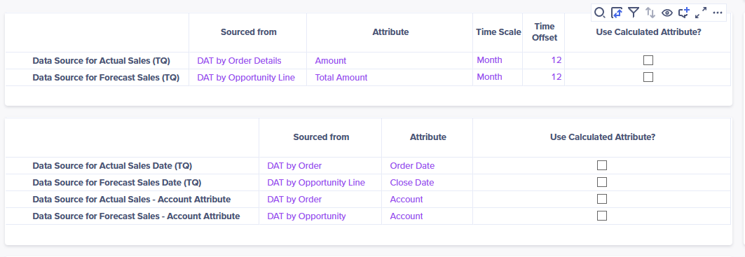
Scenario Planning Examples -

Slide 14
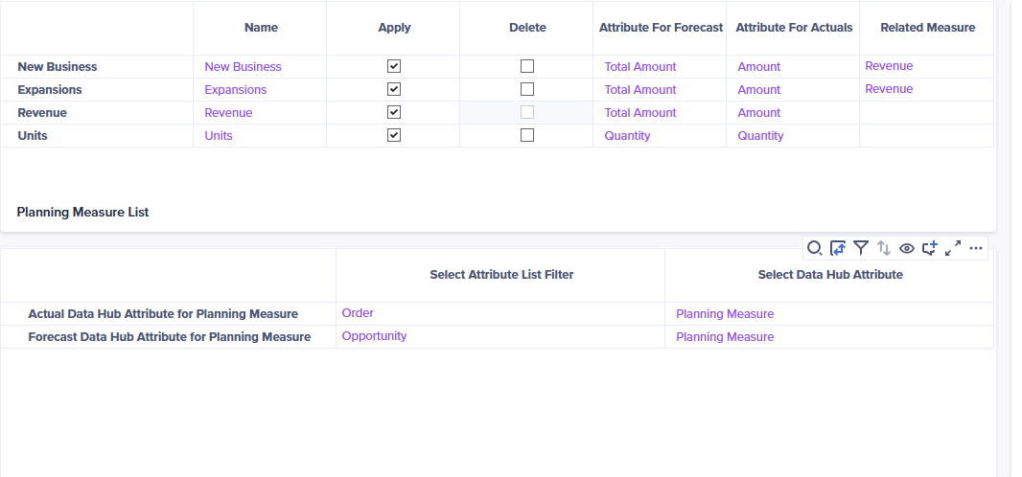
Scenario Planning Examples -

Slide 15
Optimizer

Slide 16
Optimizer – Add Pipeline Amount as Objective
Add additional or delete existing Objectives to be used for planning. The default objectives can also be renamed.
Check or uncheck the hierarchy levels desired where Geography Constraints are applied during planning.
Select the attribute of the Account list that is used as the constraints and Mix Constraints for territory optimization process.
Note: The attributes should be enabled for Calculate to be available for selection.

Slide 17
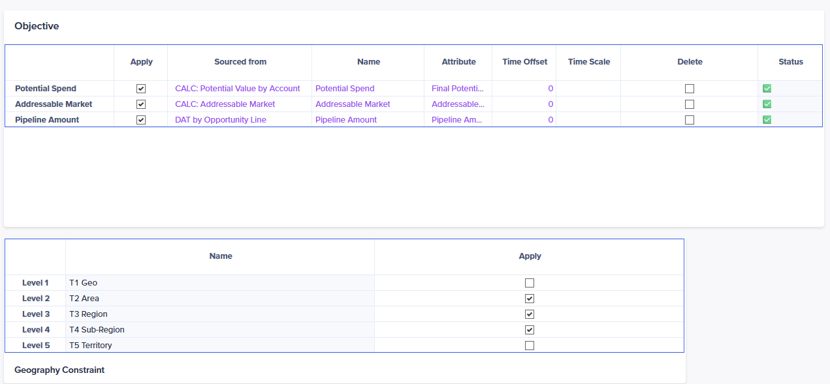
Optimizer Examples -

Slide 18
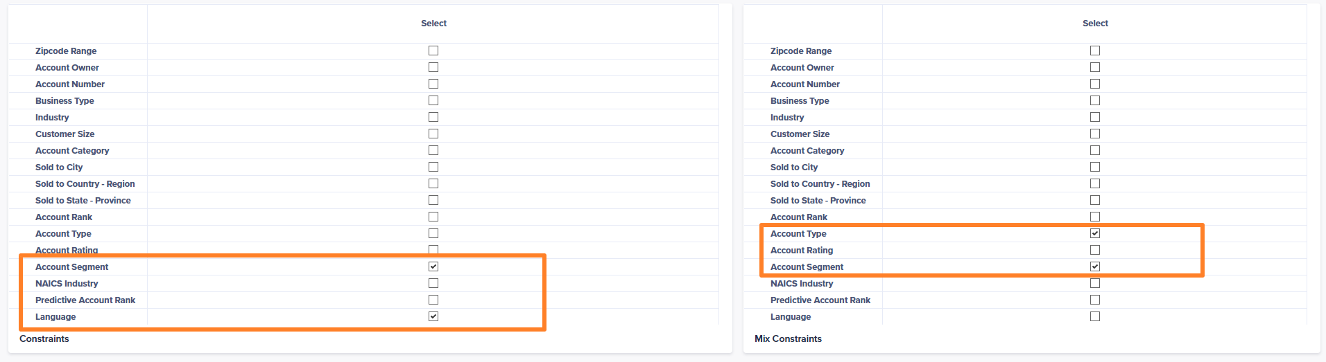
Optimizer Examples -

Slide 19
Historical Data Reporting/ Account Value KPI

Slide 20
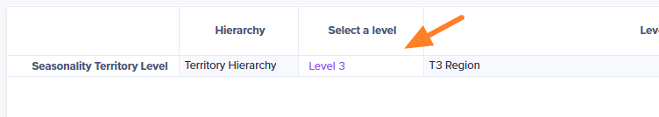
Historical Data Reporting – As is
Choose the level of the territory hierarchy to calculate seasonality percentages by month
  Discuss seasonality approach with the customer

Slide 21
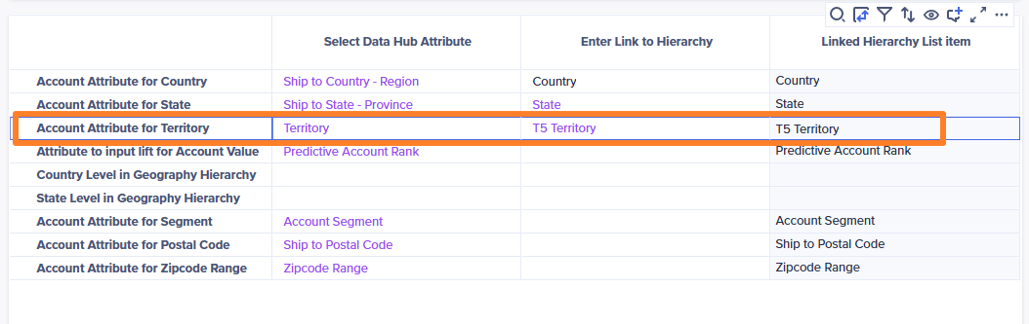
Account Value KPI – As is
Ensure to capture “Account attribute for Territory for account to territory assignment initialization

Slide 22
Target Allocation

Slide 23
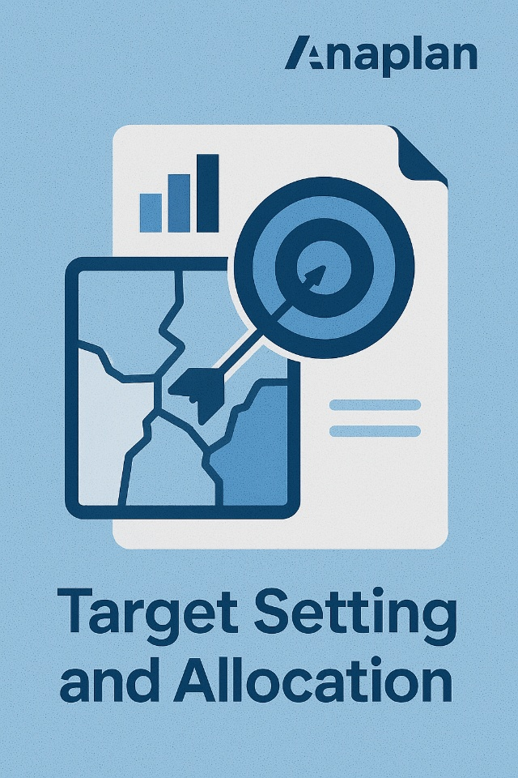
Target Allocations
Select the level of territory to initiate top-down target cascading
Select the time dimension level for target setting during import
Capture additional target setting dimensions when applicable *
Add Pipeline Amount as an allocation method

Slide 24
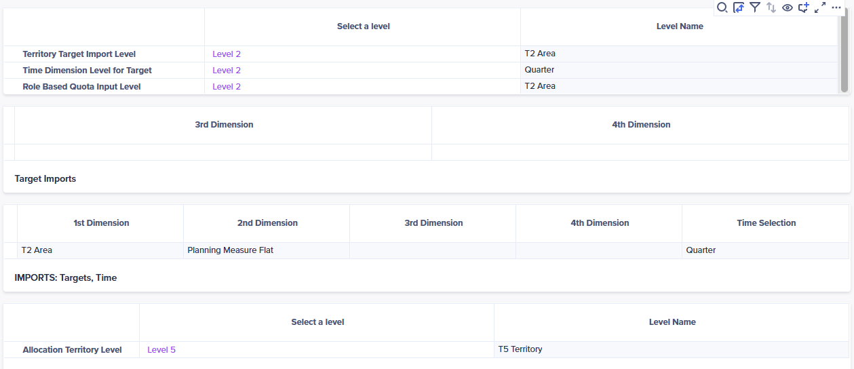
Target Allocation Examples -

Slide 25
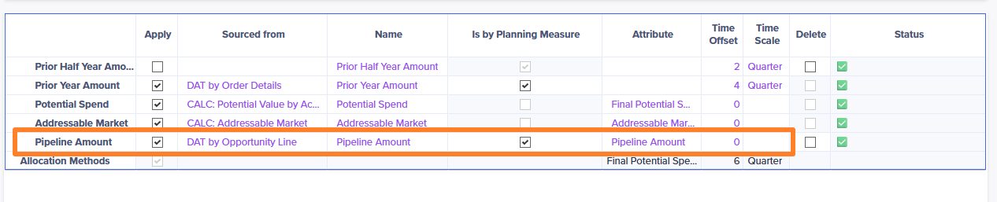
Target Allocation Examples -

Slide 26
Territory & Resource Assignment

Slide 27

Territory Assignment –
Select assignment destination for accounts, Sales Reps, and first-line managers
Define time dimension level for quota*
Hint: Majority of the time, quota will be set at the monthly level

Slide 28
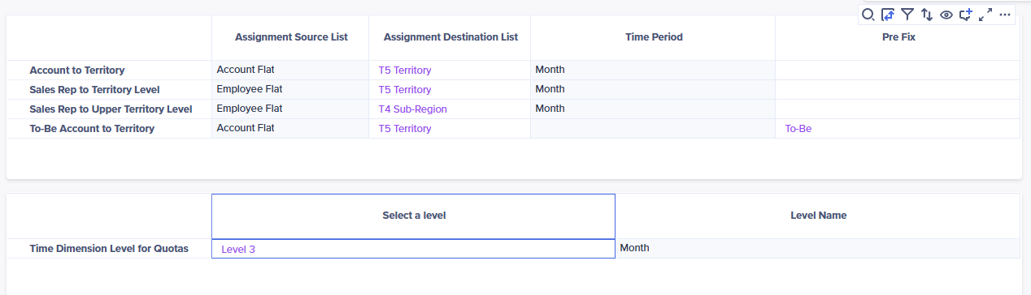
Territory Assignment Examples -

Slide 29

Resource Assignment –
Select Sales leader and overlay levels
Select Applicable approval levels
Ensure “Sales Rep Attribute for Territory” is populated for the initial Rep to territory assignment

Slide 30
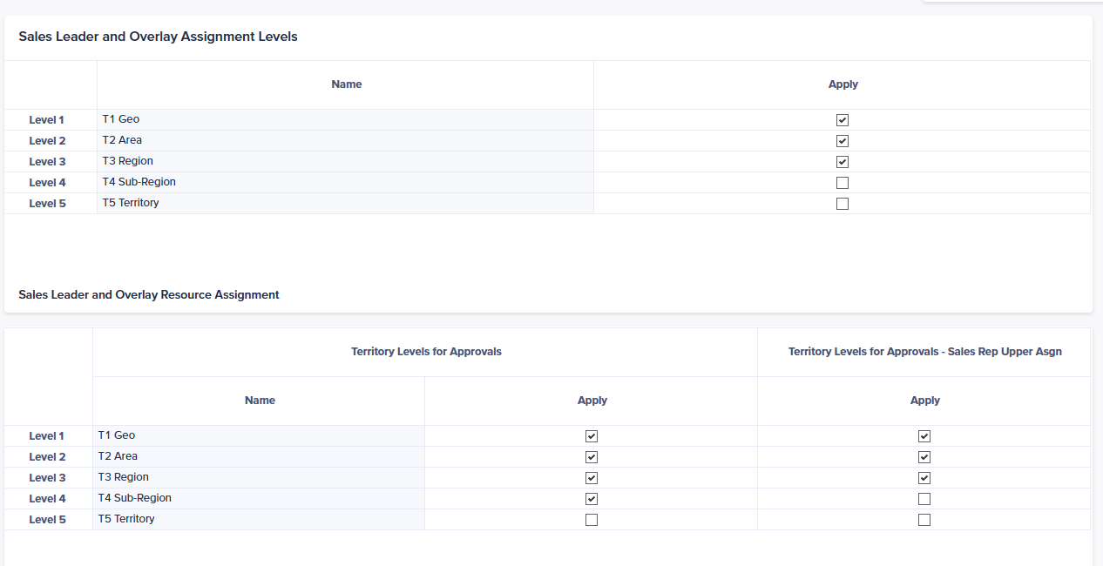
Resource Assignment Examples -

Slide 31
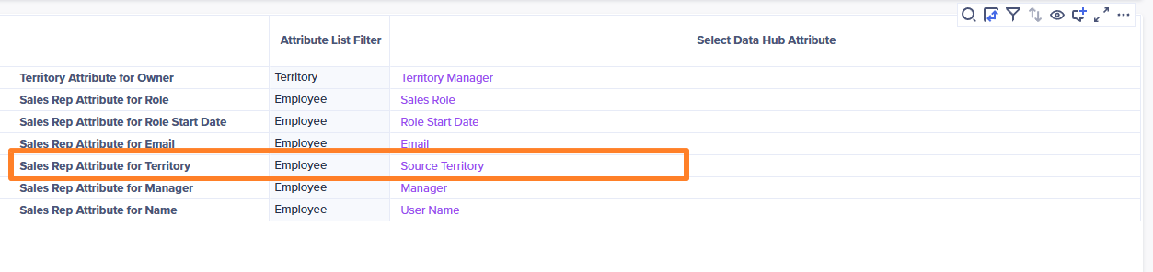
Resource Assignment Examples -

Slide 32
Rule-based Assignment

Slide 33

Rule-based Assignment–
Select account attributes that will qualify accounts to be included in Rule-based assignment
Select account attributes that will be used as part of the rule to define territory parameters
Hint: Selected attributes need to be list formatted line item

